Slide 1
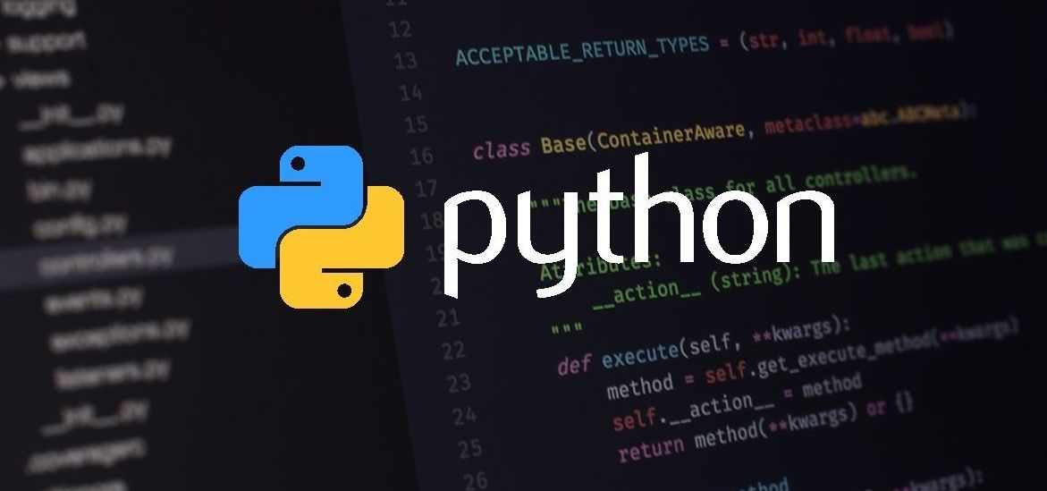

Slide 2

ABOUT YOUR TRAINER

Slide 3

ABOUT THE COURSE
This course’s objective is to provide all the basic knowledge of python. Starting from basic python code till the end in object oriented programming in python.
Fortunately for beginners, Python has simple easy-to-use syntax. This makes Python an excellent language to learn to program for beginners.
Learn how to use and create functions, sorting different elements, Lambda function, error handling techniques and using modules in Python
In this course we will cover every python topics with syntax and a small example. It makes very easy for students to understand a topic.

Slide 4
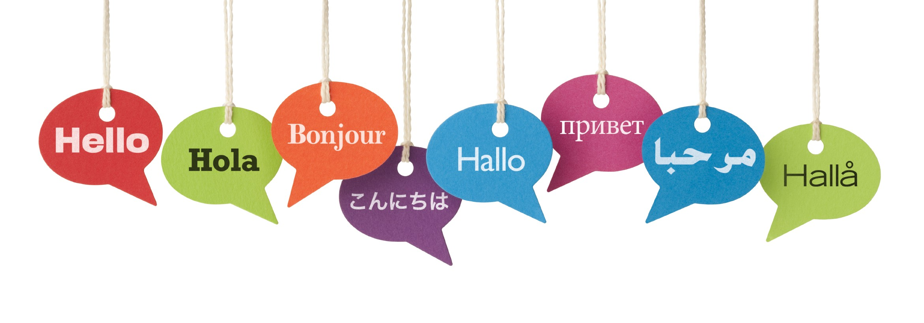
HOW TO LEARN A LANGUAGE
THE LANGUAGE WE SPEAK
THE LANGUAGE WE USE TO CODE
Alphabets
Numbers
Small words
Forming a sentence
Trying an conversation
Writing a paragraph
And so on
Basic syntax
Variable, key words and operators
Small code(hello world)
Learning by errors
Trying a small problem
Keep practicing

Slide 5
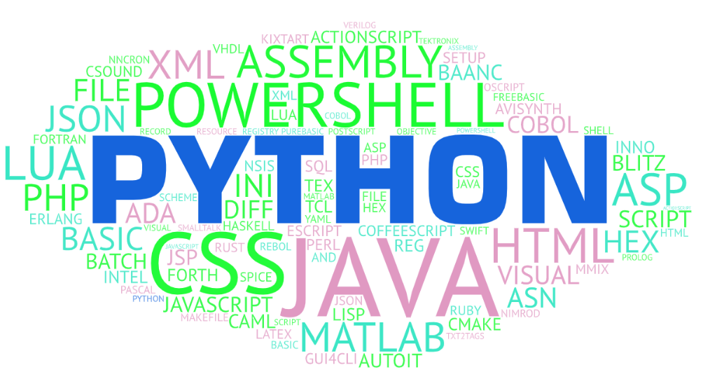
FEW THINGS ABOUT PYTHON
Python is developed by Guido van Rossum. Guido van Rossum started implementing Python in 1989. Python is a very simple programming language so even if you are new to programming, you can learn python without facing any issues.
Pros of python:
Easy to learn
Easy to read
Faster to write
Broad standard library
Cross-platform
Interpreter language

Slide 6
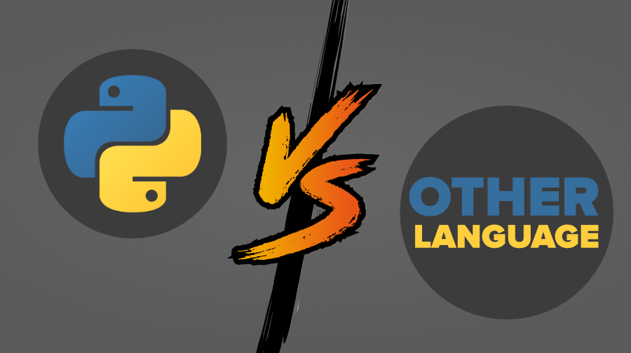

Slide 7
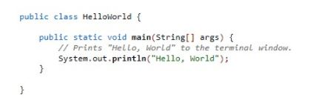
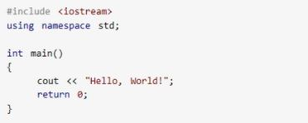
JAVA
C++
PYTHON

Slide 8

SETTING UP A PLATFORM FOR WORKING ON PYTHON

Slide 9

Google Colaboratory (colab)
You can perform the following using Google Colab.
Write and execute code in Python
Execute your code faster
Create/Upload/Share notebooks
Import/Save notebooks from/to Google Drive
Import/Publish notebooks from GitHub
No need to install any software
Free Cloud service with free GPU

Slide 10
Basic syntax
Lines and Indentation
Python provides no braces to indicate blocks of code for class and function definitions or flow control. Blocks of code are denoted by line indentation, which is rigidly enforced.
The number of spaces in the indentation is variable, but all statements within the block must be indented the same amount. For example
if True:
print(“True”)
else:
print(“False”)
However, the following block generates an error −
if True:
print(“True”)
else :
print(“False”)

Slide 11
COMMENTS
Single line comment
# This is how to comment in python
# This is a single line comment
Multi line comment
‘’’
This is a multi line
Comment.
‘’’

Slide 12
Variables
Variables are nothing but reserved memory locations to store values. This means that when you create a variable you reserve some space in memory.
Based on the data type of a variable, the interpreter allocates memory and decides what can be stored in the reserved memory. Therefore, by assigning different data types to variables, you can store integers, decimals or characters in these variables.
The operand to the left of the = operator is the name of the variable and the operand to the right of the = operator is the value stored in the variable. For example
Name=“abc”
Identifiers or variable name Age=20 Values stored in the variable names
Height=5.9
To find the type of the variable we will use type() function.

Slide 13
Keywords
Keywords are the reserved words in Python.
We cannot use a keyword as a Variable name, Function name or any other identifier. They are used to define the syntax and structure of the Python language.
In Python, keywords are case sensitive.
There are 33 keywords in Python 3.7. This number can vary slightly over the course of time.
All the keywords except True,False and None are in lowercase and they must be written as they are. The list of all the keywords is given below.
'False', 'None', 'True', 'and', 'as', 'assert', 'break', 'class', 'continue', 'def', 'del', 'elif', 'else', 'except', 'finally', 'for', 'from', 'global', 'if', 'import', 'in', 'is', 'lambda', 'nonlocal', 'not', 'or', 'pass', 'raise', 'return', 'try', 'while', 'with', 'yield‘.
To find what are the keywords in python just type:
print(keyword.kwlist)

Slide 14
Python Identifiers
An identifier is a name given to entities like class, functions, variables, etc. It helps to differentiate one entity from another.
Rules for writing identifiers
Identifiers can be a combination of letters in lowercase (a to z) or uppercase (A to Z) or digits (0 to 9) or an underscore _ .Names like var_1, myclass, print_this_to_screen are valid.
An identifier cannot start with a digit, 1variable is invalid, but variable_1 is valid.
We cannot use special symbols like !, @, #, $, % etc. in our identifier.
An identifier can be of any length.

Slide 15
Python input
Syntax for input function:
input([prompt])
Where prompt is the string we wish to display on the screen. It is optional
Code:
Num=input(“entr a number.”)
Enter a number. 10
Print(Num)
‘10’

Slide 16
Python output
Syntax for print function.
print(objects, sep=‘ * ’ , end=‘\n’)
Where
object = Values to be printed.
sep = separator is used between the values.
After all values are printed end is used. In default into a new line.

Slide 17
Python operators
Operators are special symbols in Python that carry out arithmetic or logical computation. The value that the operator operates on is called the operand.
There are various types of operators. Some of them are
Arithmetic operators
Comparison operators
Logical operators
Assignment operators

Slide 18
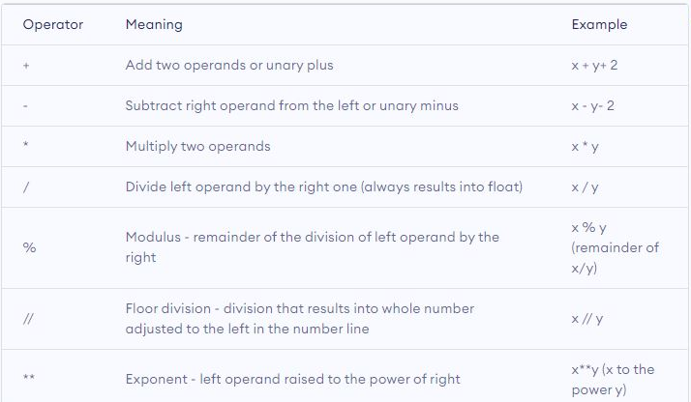
Arithmetic Operators
Arithmetic operators are used to perform mathematical operations like addition, subtraction, multiplication, etc.

Slide 19
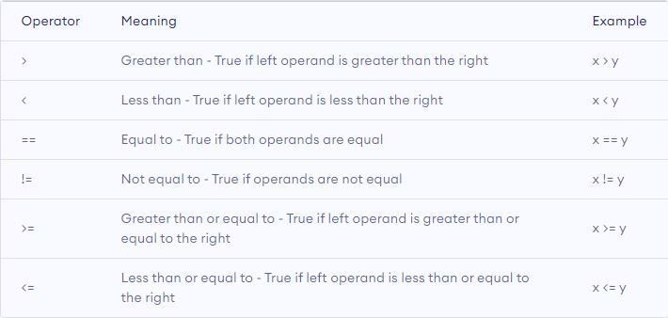
Comparison Operators
Comparison operators are used to compare values. It returns either True or False according to the condition.

Slide 20
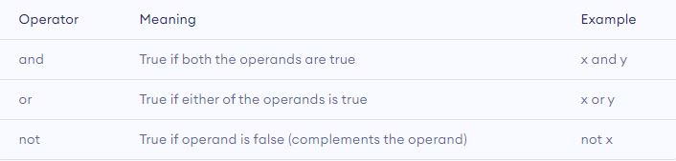
Logical Operator
Logical operators are and, or and not.

Slide 21
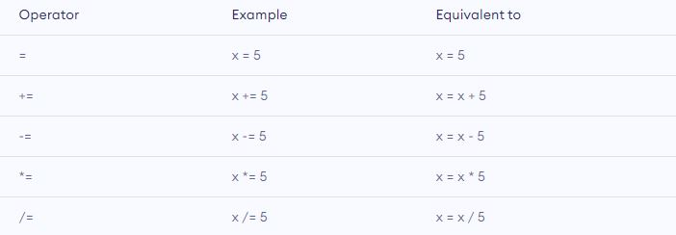
Assignment Operator
Assignment operators are used in Python to assign values to variables.

Slide 22


Slide 23
Quiz
1. Is Python an interpreter or compiler driven language?
2. What do you think you require to get into colab?
3. How do you insert COMMENTS in Python code?
4. What is the correct syntax to output the type of a variable in Python?
a)print(typeof(x))
b)print(typeof x)
c)print(type(x))
5. What is the value that the operator operates on is called ?

Slide 24
Answers
Python is an interpreter language
You will only need an gmail ID
Using # (or)’’’
Print(type(x))
Operand

Slide 25
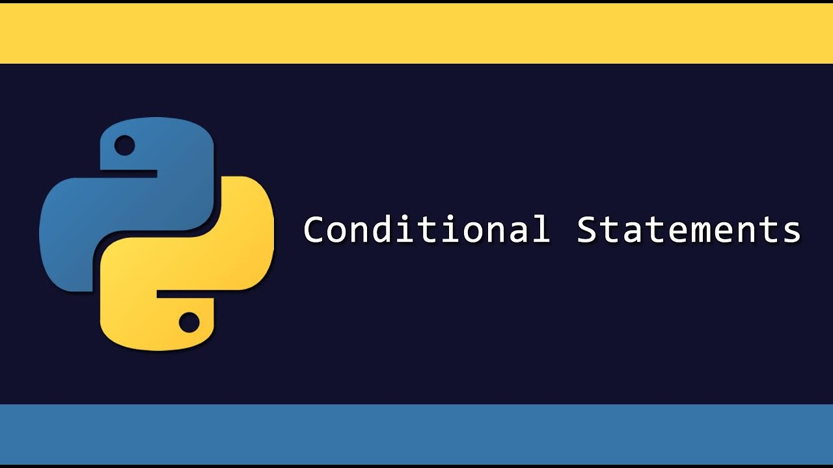

Slide 26
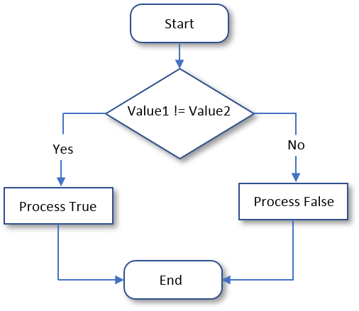
Conditional Statements
What makes programming so much more powerful ?
Conditional statements. The ability to test a variable against a value and act in one way if the condition is met by the variable or another way if not. They are also commonly called by programmers if statements.

Slide 27
Types of If statement
There are four different types of if statements. They are :
If statement
If ….else statement
If….elif….else
Nested if

Slide 28
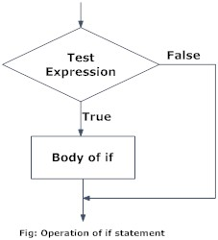
Python if statement
Decision making is required when we want to execute a code only if a certain condition is satisfied.
Python if Statement Syntax
if test expression:
statement(s)
Here, the program evaluates the test expression and will execute statements only if the test expression is true.
If the test expression is false, the statement(s) is not executed.

Slide 29
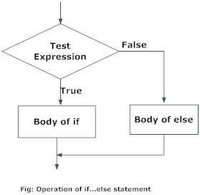
Python if...else Statement
Syntax of if...else
if test expression:
body of if
else:
body of else
The if…else statement evaluates test expression and will execute the body of if only when the test condition is true.
If the condition is false, the body of else is executed.

Slide 30
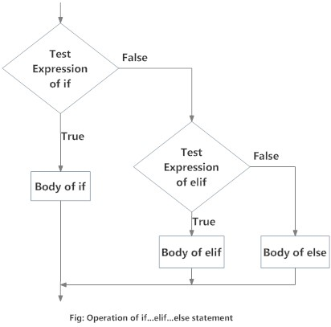
Python if...elif...else Statement
Syntax of if...elif...else
if test expression:
Body of if
elif test expression:
Body of elif
else:
Body of else
The elif is short for else if. It allows us to check for multiple expressions.
If the condition for if is False, it checks the condition of the next elif block and so on.
If all the conditions are False, the body of else is executed.
Only one block among the several if...elif...else blocks is executed according to the condition.
The if block can have only one else block. But it can have multiple elif blocks.

Slide 31
Python Nested if statements
We can have a if...elif...else statement inside another if...elif...else statement. This is called nesting in computer programming.
Any number of these statements can be nested inside one another. Indentation is the only way to figure out the level of nesting. They can get confusing, so they must be avoided unless necessary.

Slide 32
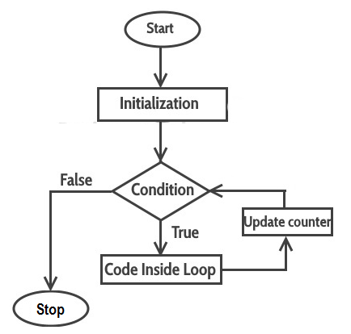
Python for loop
For loop is a sequence of instructions that is repeated until a certain condition is reached.
A for loop has two sections: a header specifying the iterating conditions, and a body which is executed once per iteration . The header often declares an explicit loop counter or loop variable, which allows the body to know which iteration is being executed.
SYNTAX:
for val in sequence:
Body of for

Slide 33
Types of for loop
There are four types of for loop :
For loop
For with range
For …. Else
Nested for loop

Slide 34
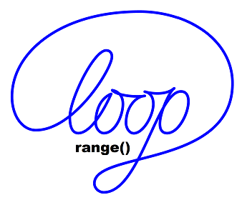
Python for loop with range()
The range function in for loop is actually a very powerful mechanism when it comes to creating sequences of integers. It can take one, two, or three parameters. It returns or generates a list of integers from some lower bound (zero, by default) up to (but not including) some upper bound , possibly in increments (steps) of some other number (one, by default).
Range function with three different parameters :
range(stop)
range(start,stop)
range(start,stop,step)

Slide 35
For loop with else
A for loop can have an optional else block as well. The else part is executed if the items in the sequence used in for loop exhausts.

Slide 36
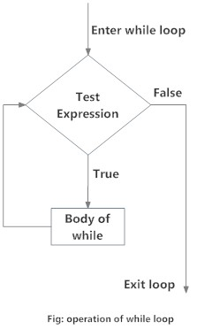
PYTHON WHILE LOOP
The while loop in Python is used to iterate over a block of code as long as the test expression (condition) is true.
We generally use this loop when we don't know the number of times to iterate beforehand.
Syntax of while Loop
while test_expression:
Body of while
In the while loop, test expression is checked first. The body of the loop is entered only if the test_expression evaluates to True. After one iteration, the test expression is checked again. This process continues until the test_expression evaluates to False.

Slide 37
CONTROL STATEMENTS
Control statements in python are used to control the order of execution of the program based on the values and logic.
Python provides us with 3 types of Control Statements:
Continue
Break
Pass

Slide 38


Slide 39
QUIZ
What is the value of x?
x=10
while(x<100):
x=x+2
print(x)
101
99
Infinit
100

Slide 40
2.What is the output of the following range function?
for num in range(2,-5,-1):
print(num, end=", ")
2, 1, 0
2, 1, 0, -1, -2, -3, -4, -5
2, 1, 0, -1, -2, -3, -4

Slide 41
3. What is the output of the following loop?
for l in 'Jhon':
if l == 'o':
pass
print(l, end=", ")
J, h, n,
J, h, o, n,

Slide 42
4. What is the output of the following for loop and range() function?
for num in range(-2,-5,-1):
print(num, end=", ")
-2, -1, -3, -4
-2, -1, 0, 1, 2, 3,
-2, -1, 0
-2, -3, -4,
5. if -3 will evaluate to true
True
False

Slide 43
Answers
D
C
B
D
A

Slide 44
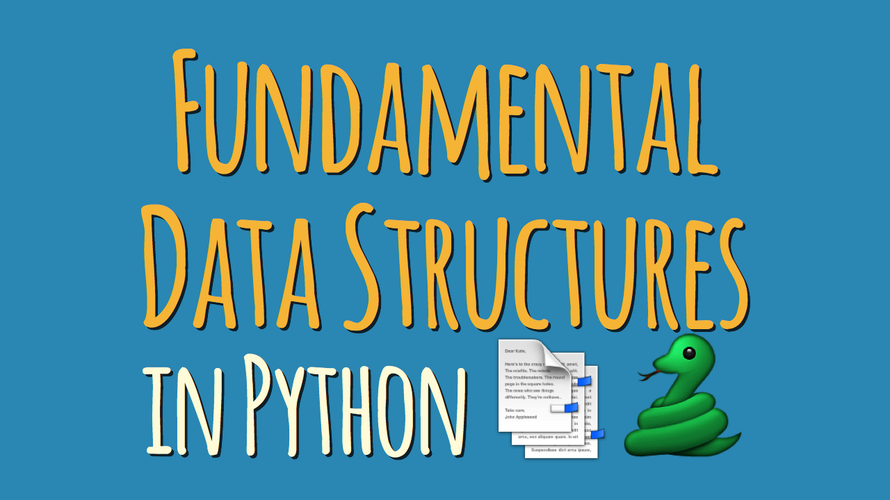

Slide 45
DATA STRUCTURES
You can think of a data structure as a way of organizing and storing data such that we can access and modify it efficiently. Now, let’s
begin with our data structures. The various types are:
List is a collection which is ordered and changeable. Allows duplicate members.
Tuple is a collection which is ordered and unchangeable. Allows duplicate members.
Set is a collection which is unordered and unindexed. No duplicate members.
Dictionary is a collection which is unordered, changeable and indexed. No duplicate members.

Slide 46
LIST
A list in Python is a heterogeneous container for items. This would remind you of an array in C++, but since Python does not support arrays, we have python lists.
Syntax for lists:
languages=[‘C++’, ‘Python’, ‘Scratch’]
You can put any kind of value in a list. This can be a string, a Tuple, a Boolean, or even a list itself.
List1=[1,[2,3],(4,5), False, ’No’]

Slide 47
TUPLE
This Python Data Structure is like a, like a list in Python, is a heterogeneous container for items. But the major difference between the two (tuple and list) is that a list is mutable, but a tuple is immutable. This means that while you can reassign or delete an entire tuple, you cannot do the same to a single item or a slice.
To declare a tuple, we use parentheses.
Colors=(‘blue’, ‘green’, ‘yellow’)

Slide 48
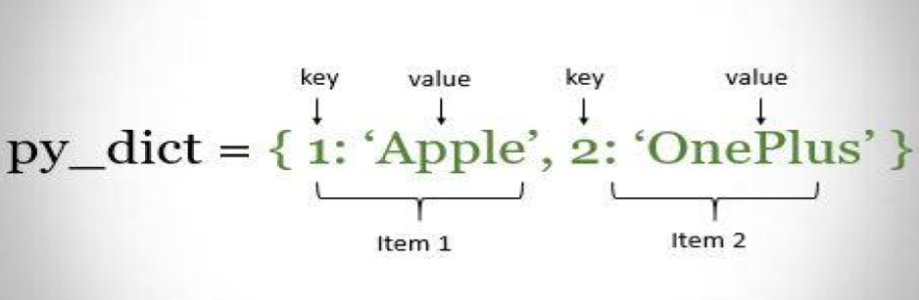
DICTIONARY
We will take a look at Python dictionaries. Think of a real-life dictionary. What is it used for? It holds word-meaning pairs. Likewise, a Python dictionary holds key-value pairs.

Slide 49
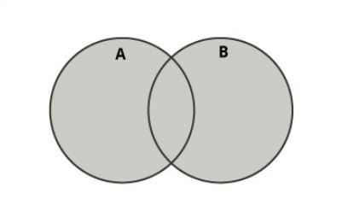
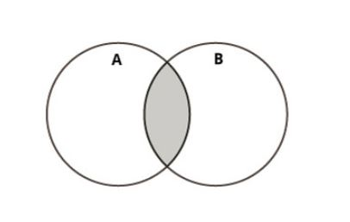
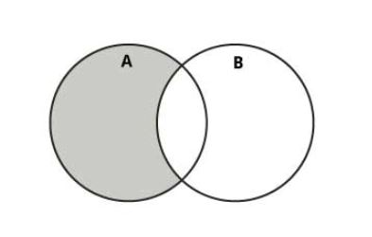
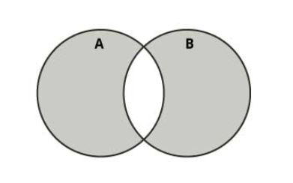
Python Sets
This is one of the important Python Data Structures. A Python set is a slightly different concept from a list or a tuple. A set, in Python, is just like the mathematical set. It does not hold duplicate values and is unordered. However, it is not immutable, unlike a tuple.
UNION INTERSECT DIFFRENCE SYMMETRIC

Slide 51
QUIZ
1. Find the output
sampleList = [10, 20, 30, 40, 50]
sampleList.pop()
print(sampleList)
sampleList.pop(2)
print(sampleList)

Slide 52
2. Find the output
aList = [4, 8, 12, 16]
aList[1:4] = [20, 24, 28]
print(aList)
3. Find the output
sampleList = [10, 20, 30, 40, 50]
sampleList.append(60)
print(sampleList)
sampleList.append(60)
print(sampleList)

Slide 53
4. Choose the correct answer. How to combine two lists.
listOne = ['a', 'b', 'c', 'd']
listTwo = ['e', 'f', 'g']
newList = listOne + listTwo
newList = extend(listOne, listTwo)
newList = listOne.extend(listTwo)
newList.extend(listOne, listTwo)
5.Select the correct way to print Emma’s age.
student = {1: {'name': 'Emma', 'age': '27', 'sex': 'Female'},
2: {'name': 'Mike', 'age': '22', 'sex': 'Male'}}
student[0][1]
student[1][“age”]
student[0][“age”]

Slide 54
6. Please select all correct ways to empty the following dictionary
student = { "name": "Emma", "class": 9, "marks": 75 }
del student
del student[0:2]
student.clear()
7. In Python, Dictionaries are immutable
False
True
8. Select correct ways to create an empty dictionary
sampleDict = {}
sampleDict = dict()

Slide 55
9.Output of this code
aTuple = (100, 200, 300, 400, 500)
aTuple.pop(2)
print(aTuple)
(100, 200, 400, 500)
(100, 300, 400, 500)
AttributeError
10. What is the output of the following code
aTuple = (100, 200, 300, 400, 500)
aTuple[1] = 800
print(aTuple)
TypeError
(100, 800, 200, 300, 400, 500)
(800, 100, 200, 300, 400, 500)
11. The symmetric_difference() method returns a set that contains all items from both sets, but not the items that are present in both sets.
False
True

Slide 56
Answers
1.[10,20,30,40]
[10,20,40]
2.[4,20,24,28]
3.[10,20,30,40,50,60,60]
4.A
5.B
6.C
7.A
8.Both a&b
9.C
10.A
11.B

Slide 57
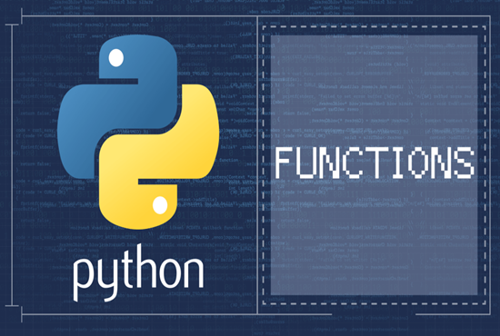

Slide 58
Functions in Python
What is a function in Python?
In Python, a function is a group of related statements that performs a specific task.
Functions help break our program into smaller and modular chunks. As our program grows larger and larger, functions make it more organized and manageable.
Furthermore, it avoids repetition and makes the code reusable.

Slide 59
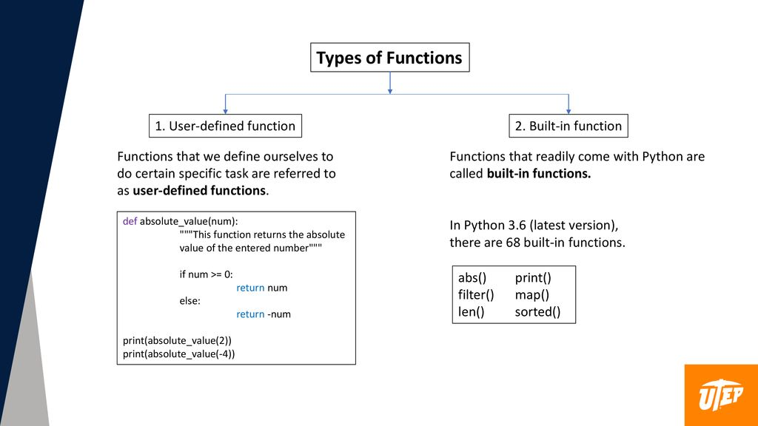

Slide 60
User defined Function
Syntax for defining a function:
def function_name(parameters):
"""docstring"""
statement(s)
Syntax for calling a function:
function_name()
Above shown is a function definition that consists of the following components.
Keyword def that marks the start of the function header.
A function name to uniquely identify the function. Function naming follows the same rules of writing identifiers in Python.
Parameters (arguments) through which we pass values to a function. They are optional.
A colon (:) to mark the end of the function header.
Optional documentation string (docstring) to describe what the function does.
One or more valid python statements that make up the function body. Statements must have the same indentation level (usually 4 spaces).
An optional return statement to return a value from the function.

Slide 61
Scope and Lifetime of variables
Scope of a variable is the portion of a program where the variable is recognized. Parameters and variables defined inside a function are not visible from outside the function. Hence, they have a local scope.
The lifetime of a variable is the period throughout which the variable exits in the memory. The lifetime of variables inside a function is as long as the function executes.
They are destroyed once we return from the function. Hence, a function does not remember the value of a variable from its previous calls.
Here is an example to illustrate the scope of a variable inside a function.
Here, we can see that the value of x is 20 initially. Even though the function my_func() changed the value of x to 10, it did not affect the value outside the function.
This is because the variable x inside the function is different (local to the function) from the one outside. Although they have the same names, they are two different variables with different scopes.
On the other hand, variables outside of the function are visible from inside. They have a global scope.
Example:
def my_func():
x = 10
print("Value inside function:",x)
x = 20
my_func()
print("Value outside function:",x)
Output
Value inside function: 10
Value outside function: 20

Slide 62
Python Anonymous/Lambda Function
What are lambda functions in Python?
In Python, an anonymous function is a function that is defined without a name.
While normal functions are defined using the def keyword in Python, anonymous functions are defined using the lambda keyword.
Hence, anonymous functions are also called lambda functions.
Syntax of Lambda Function in python
lambda arguments: expression
# Program to show the use of lambda functions
double = lambda x: x * 2
print(double(5))
Output
10
The above code is nearly the same as:
def double(x):
return x * 2
Print(double(5))

Slide 63
Use of Lambda Function in python
We use lambda functions when we require a nameless function for a short period of time.
In Python, we generally use it as an argument to a higher-order function (a function that takes in other functions as arguments). Lambda functions are used along with built-in functions like filter(), map() etc.
Map()
The map(function,list of values) function in Python takes in a function and a list.
The function is called with all the items in the list and a new list is returned which contains items returned by that function for each item.
Filter()
The filter(function,list of values) function in Python takes in a function and a list as arguments.
The function is called with all the items in the list and a new list is returned which contains items for which the function evaluates to True.

Slide 64
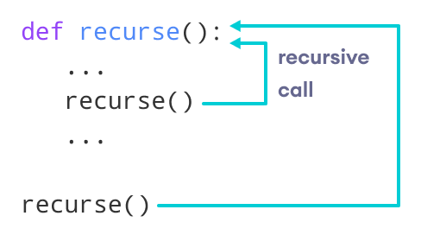
Recursive function
What is recursion?
Recursion is the process of defining something in terms of itself.
A physical world example would be to place two parallel mirrors facing each other. Any object in between them would be reflected recursively.
Python Recursive Function
In Python, we know that a function can call other functions. It is even possible for the function to call itself. These types of construct are termed as recursive functions.

Slide 65
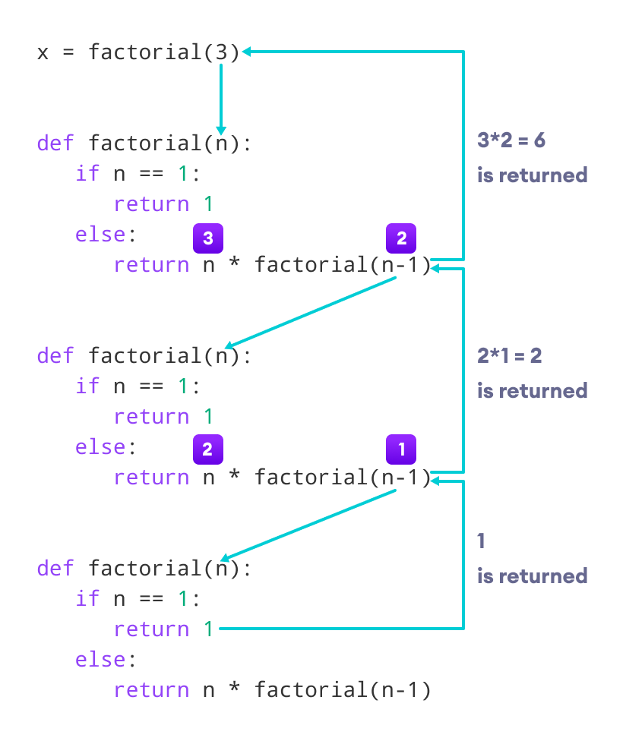
EXAMPLE
def factorial(n):
"""This is a recursive function
to find the factorial of an integer"""
if n == 1:
return 1
else:
return (n * factorial(n-1))
num = 3
print("The factorial of", num, "is", factorial(num))
Output
The factorial of 3 is 6

Slide 66
PYTHON RANDOM MODULE:
Few functions inside Random Module:
1.random()
random.random(): Generates a random float number between 0.0 to 1.0. The function doesn't need any arguments.
2.randint()
random.randint(startvalue,endvalue): Returns a random integer between the specified integers.
3.randrange()
random.randrange(startvalue,endvalue,stepvalue): Returns a randomly selected element from the range created by the start, stop and step arguments. The value of start is 0 by default. Similarly, the value of step is 1 by default.
4.choice()
random.choice(set of values in text,list or tuple): Returns a randomly selected element from a non-empty sequence. An empty sequence as argument raises an IndexError.
5.shuffle()
random.shuffle(): This functions randomly reorders the elements in a list.

Slide 68
QUIZ
1.What is the output of the add() function call
def add(a, b):
return a+5, b+5
result = add(3, 2)
print(result)
15
8
(8, 7)
Syntax Error
2. str = “PYTHON”
Choose the correct function to pick a single character from a given string randomly.
random.sample(str)
random.choice(str)
random.get(str, 1)

Slide 69
3.Choose the correct function from the following list to get the random integer between 99 to 200, which is divisible by 3.
random.randrange(99, 200, 3)
random.randint(99, 200, 3)
random.random(99, 200, 3)
4. From which module we can import factorial function?
5. Python function always returns a value?
False
True

Slide 70
Answers
1.C
2.B
3.A
4. Import math
5. True(If you do not include any return statement in Python function, it automatically returns None. So, a python function always returns a value.)

Slide 71
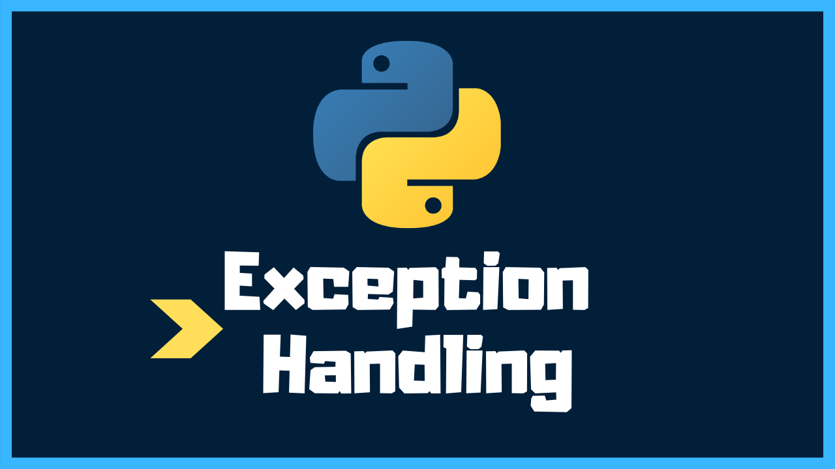

Slide 72
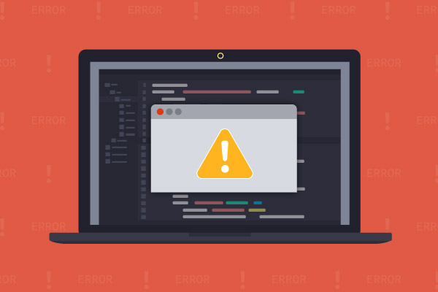
TYPES OF ERRORS
No matter how smart or how careful you are, errors are your constant companion. With practice, you will get slightly better at not making errors, and much, much better at finding and correcting them.
There are three kinds of errors:
syntax errors
runtime errors
logic errors.

Slide 73
SYNTAX ERRORS
These are errors where the compiler finds something wrong with your program, and you can't even try to execute it. For example, you may have incorrect punctuation, or may be trying to use a variable that hasn't been declared.
Syntax errors are the easiest to find and correct. The compiler will tell you where it got into trouble, and its best guess as to what you did wrong. Usually the error is on the exact line indicated by the compiler, or the line just before it; however, if the problem is incorrectly nested braces, the actual error may be at the beginning of the nested block.

Slide 74
RUNTIME ERRORS
A runtime error is an application error that occurs during program execution. Runtime errors are usually a category of exception that encompasses a variety of more specific error types such as logic errors , IO errors , encoding errors , undefined object errors , division by zero errors , and many more.
A program with a runtime error is one that passed the interpreter's syntax checks, and started to execute.

Slide 75
LOGIC ERRORS
A logic error, or bug, is when your program compiles and runs, but does the wrong thing. The Java system, of course, has no idea what your program is supposed to do, so it provides no additional information to help you find the error.
Ways to track down a logic error include:
Think about what the program must have done in order to produce the results it did. This will lead you to where the error must have occurred.
Put in print statements to help you figure out what the program is actually doing.
Use a debugger to step through your program and watch what it does.

Slide 76
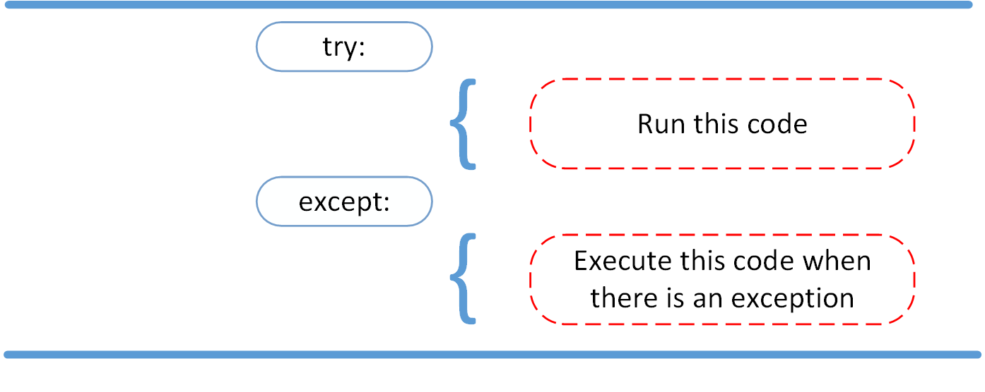
Exception Handling in python

Slide 77
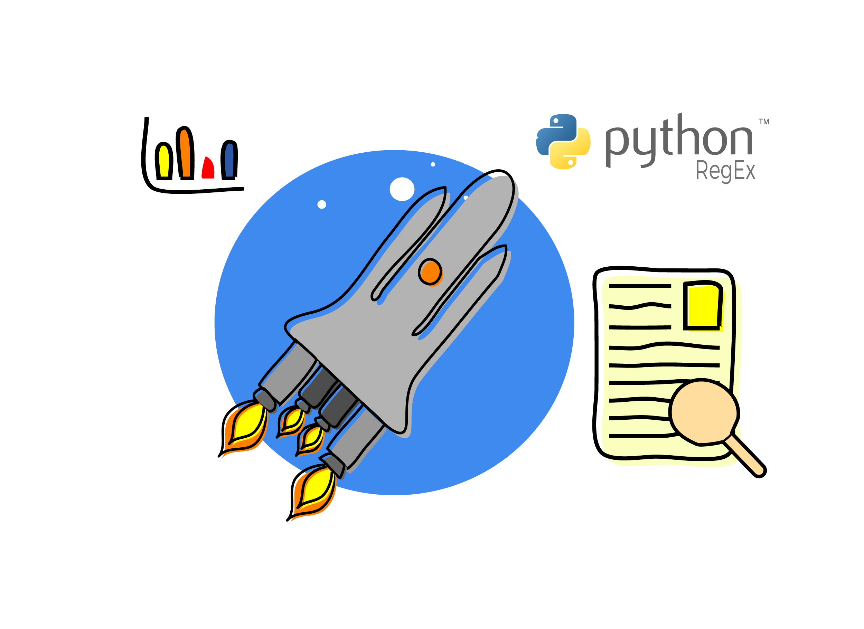

Slide 78
Python RegEx
A RegEx, or Regular Expression, is a sequence of characters that forms a search pattern.
RegEx can be used to check if a string contains the specified search pattern.
Python has a built-in package called re, which can be used to work with Regular Expressions.
RegEx Functions
The re module offers a set of functions that allows us to search a string for a match:
Function Description
findall() Returns a list containing all matches
Search() Returns a Match object if there is a match anywhere in the string
Split() Returns a list where the string has been split at each match
Sub() Replaces one or many matches with a string

Slide 79
Metacharacters
Metacharacters are characters with a special meaning:
Character Description Example
[] A set of characters "[a-m]"
\ Signals a special sequence (can also be used to escape special characters) "\d"
. Any character (except newline character) "he..o"
^ Starts with "^hello"
$ Ends with "world$"
* Zero or more occurrences "aix*"
+ One or more occurrences "aix+"
{} Exactly the specified number of occurrences "al{2}"
| Either or "falls|stays"
() Capture and group

Slide 80
Special Sequences
A special sequence is a \ followed by one of the characters in the list below, and has a special meaning:
Character Description Example
\A Returns a match if the specified characters are at the beginning of the string "\AThe"
\b Returns a match where the specified characters are at the beginning or at the end of a word
(the "r" in the beginning is making sure that the string is being treated as a "raw string") r"\bain"
r"ain\b"
\B Returns a match where the specified characters are present, but NOT at the beginning (or at the end) of a word
(the "r" in the beginning is making sure that the string is being treated as a "raw string") r"\Bain"
r"ain\B"
\d Returns a match where the string contains digits (numbers from 0-9) "\d"
\D Returns a match where the string DOES NOT contain digits "\D"
\s Returns a match where the string contains a white space character "\s"
\S Returns a match where the string DOES NOT contain a white space character "\S"
\w Returns a match where the string contains any word characters (characters from a to Z, digits from 0-9, and _chaeacters) "\w"
\W Returns a match where the string DOES NOT contain any word characters "\W"
\Z Returns a match if the specified characters are at the end of the string "Spain\Z"

Slide 81
SETS
A set is a set of characters inside a pair of square brackets [] with a special meaning:
Set Description
[arn] Returns a match where one of the specified characters (a, r, or n) are present
[a-n] Returns a match for any lower case character, alphabetically between a and n
[^arn] Returns a match for any character EXCEPT a, r, and n
[0123] Returns a match where any of the specified digits (0, 1, 2, or 3) are present
[0-9] Returns a match for any digit between 0 and 9
[0-5][0-9]Returns a match for any two-digit numbers from 00 and 59
[a-zA-Z] Returns a match for any character alphabetically between a and z, lower case OR upper case
[+] In sets, +, *, ., |, (), $,{} has no special meaning, so [+] means: return a match for any + character in the string

Slide 82
Python permutations and combinations
Combinations are arrangements of objects without regard to order,selected from a number of objects.
Permutations are the number of possible arrangements in an ordered set of objects.
If the order doesn’t matter , it is a combination.
If the order does matter, it is a permutation.

Slide 83
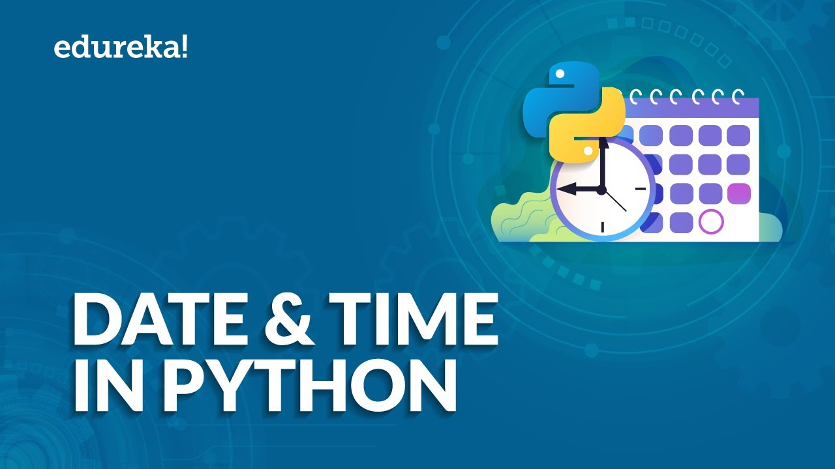
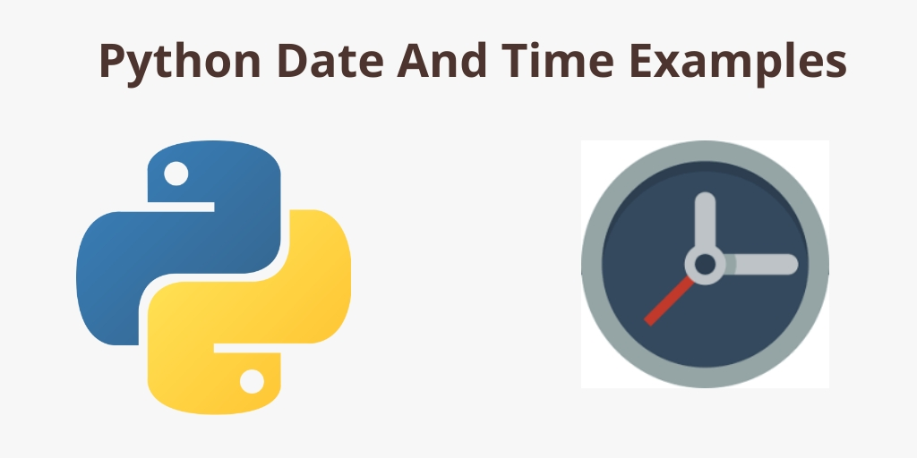

Slide 85
Quiz
1.A program runs and, during running, is asked to divide by zero. The program crashes. This is an example of:
a logic error
a run-time error
a logic error
a user error
2. A syntax error in your code means:
You have not used enough characters.
There was no defined index.
Python can't find a file to pass the code to.
There is an error with your typing and code structure.

Slide 86
Quiz
3.What will the output be from the following code? print(Hello world!)
Hello world!
SyntaxError
Hello world
print(Hello world!)
4. What is the output of the following code ?
try:
print('try')
except ValueError:
print('ValueError')
finally:
print('finally')

Slide 87
Quiz
5.Find the output?
import re
string = 'hello 12 hi 89. Howdy 34'
pattern = '\d+'
result = re.findall(pattern, string)
print(result)
6. The output of both of the print statements is the same.
import datetime
dt_1 = datetime.datetime.today()
dt_2 = datetime.datetime.now()
print(dt_1)
print(dt_2)
a) True
b) False

Slide 88
Answers
1.B
2.D
3.B
4.Try finally
First the try block is executed so try is printed,after try except will not be printed because there is no error in try.Finally will be printed as default.
5.[12,89,34]
6.False
Because there is millisecond change between dt_1 and dt_2

Slide 89
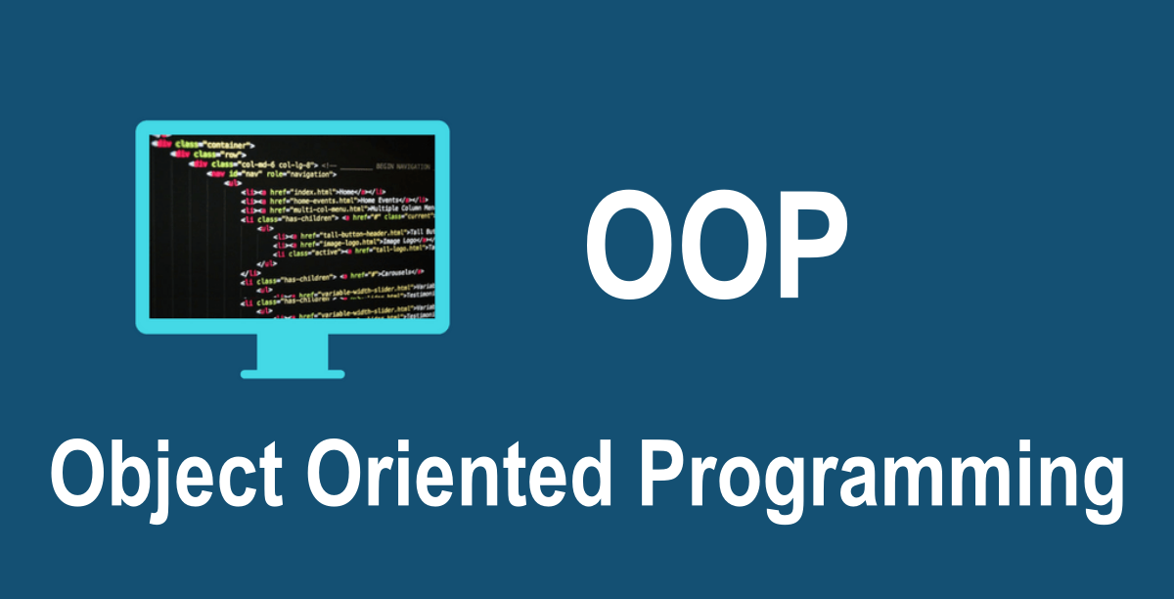
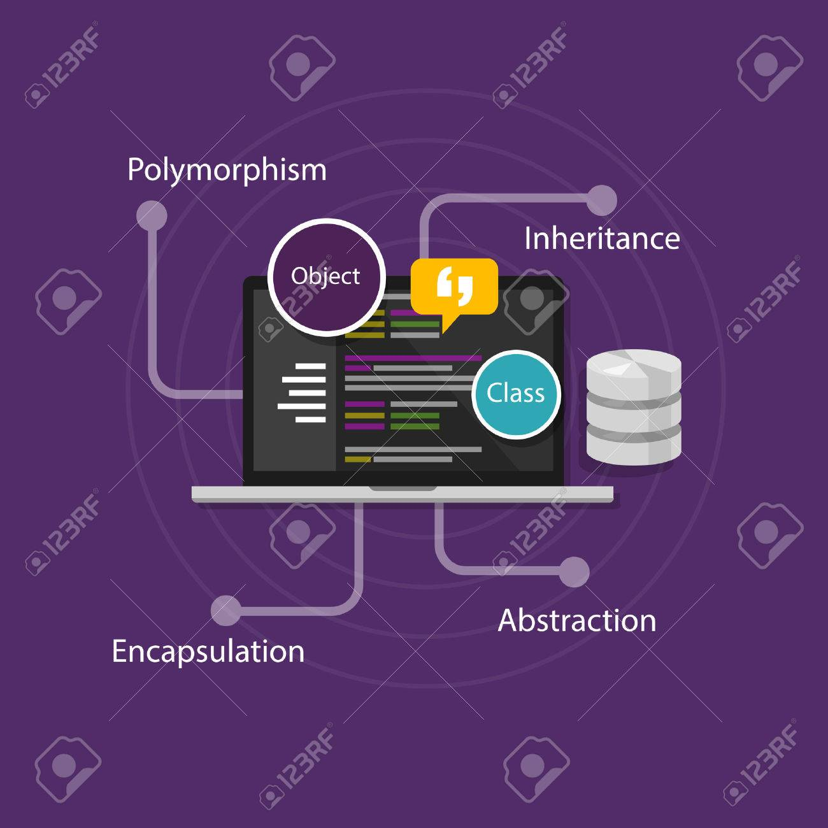

Slide 90
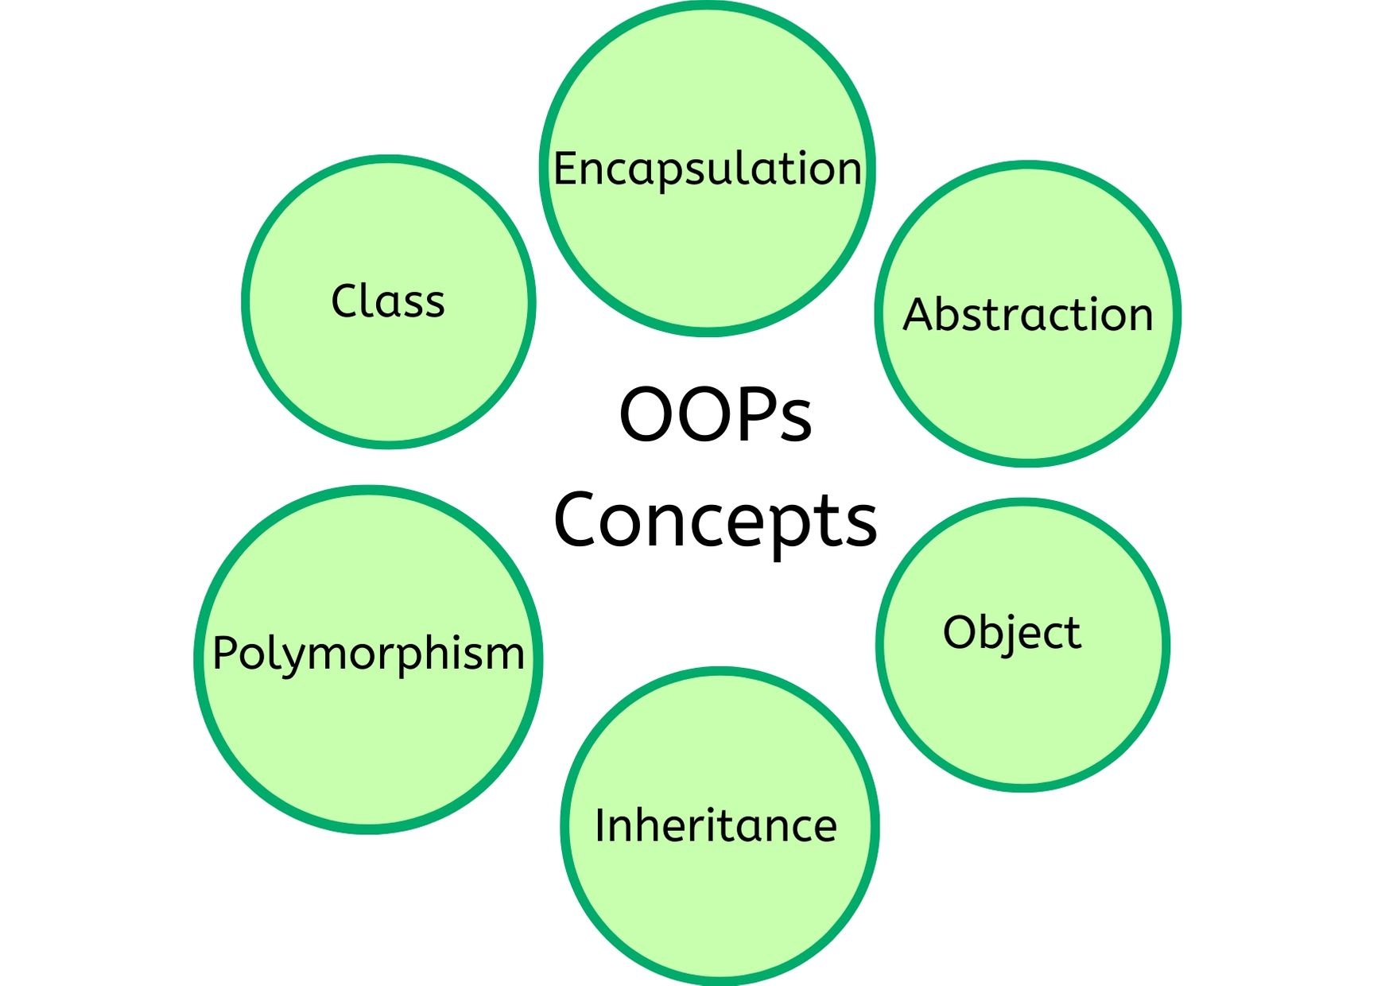

Slide 91
Python OOPs Concepts
Like other general-purpose programming languages, Python is also an object-oriented language since its beginning. It allows us to develop applications using an Object-Oriented approach. In Python, we can easily create and use classes and objects.
An object-oriented paradigm is to design the program using classes and objects. The object is related to real-word entities such as book, house, pencil, etc. The oops concept focuses on writing the reusable code. It is a widespread technique to solve the problem by creating objects.
Class
Object
Inheritance
Polymorphism
Data Abstraction
Encapsulation

Slide 92
Class
The class can be defined as a collection of objects. It is a logical entity that has some specific attributes and methods. For example: if you have an employee class, then it should contain an attribute and method, i.e. an email id, name, age, salary, etc.
Syntax
class ClassName:
<statement-1>
.
.
<statement-N>

Slide 93
Object
The object is an entity that has state and behavior. It may be any real-world object like the mouse, keyboard, chair, table, pen, etc.Everything in Python is an object, and almost everything has attributes and methods. All functions have a built-in attribute , which returns the docstring defined in the function source code.
class car:
def __init__(self,modelname, year):
self.modelname = modelname
self.year = year
def display(self):
print(self.modelname,self.year)
c1 = car("Toyota", 2016)
c1.display()

Slide 94
Inheritance
Inheritance is the most important aspect of object-oriented programming, which simulates the real-world concept of inheritance. It specifies that the child object acquires all the properties and behaviors of the parent object.
By using inheritance, we can create a class which uses all the properties and behavior of another class. The new class is known as a derived class or child class, and the one whose properties are acquired is known as a base class or parent class.
It provides the re-usability of the code.

Slide 95
Polymorphism
Polymorphism contains two words "poly" and "morphs". Poly means many, and morph means shape. By polymorphism, we understand that one task can be performed in different ways. For example - you have a class animal, and all animals speak. But they speak differently. Here, the "speak" behavior is polymorphic in a sense and depends on the animal. So, the abstract "animal" concept does not actually "speak", but specific animals (like dogs and cats) have a concrete implementation of the action "speak".

Slide 96
Encapsulation and Abstraction
Encapsulation
Encapsulation is also an essential aspect of object-oriented programming. It is used to restrict access to methods and variables. In encapsulation, code and data are wrapped together within a single unit from being modified by accident.
Data Abstraction
Data abstraction and encapsulation both are often used as synonyms. Both are nearly synonyms because data abstraction is achieved through encapsulation.
Abstraction is used to hide internal details and show only functionalities. Abstracting something means to give names to things so that the name captures the core of what a function or a whole program does.

Slide 97
Object-oriented vs. Procedure-oriented Programming languages
Object-oriented
Procedure-oriented
Object-oriented programming is the problem-solving approach and used where computation is done by using objects.
It makes the development and maintenance easier.
It simulates the real world entity. So real-world problems can be easily solved through oops.
It provides data hiding. So it is more secure than procedural languages. You cannot access private data from anywhere.
Example of object-oriented programming languages is C++, Java, .Net, Python, C#, etc.
Procedural programming uses a list of instructions to do computation step by step.
In procedural programming, It is not easy to maintain the codes when the project becomes lengthy.
It doesn't simulate the real world. It works on step by step instructions divided into small parts called functions.
Procedural language doesn't provide any proper way for data binding, so it is less secure.
Example of procedural languages are: C, Fortran, Pascal, VB etc.

Slide 98
OOP (object oriented programing)
Python is a multi-paradigm programming language. It supports different programming approaches.
One of the popular approaches to solve a programming problem is by creating objects. This is known as Object-Oriented Programming (OOP).
An object has two characteristics:
attributes
Behavior
Let's take an example:
A parrot is can be an object,as it has the following properties:
name, age, color as attributes
singing, dancing as behavior
The concept of OOP in Python focuses on creating reusable code. This concept is also known as DRY (Don't Repeat Yourself).

Slide 99
CLASS
A class in object-oriented programming serves as a blueprint for the object. A class can be considered as a map for the house. You can get an idea of what the house looks like by simply seeing the map. However, a class itself is nothing. For instance, a map is not a house, it only explains how the actual house will look.
The relationship between a class and object can be understood by looking at the relationship between a car and an Audi. An Audi is actually a car. However, there is no such thing as a car only. A car is an abstract concept, it is actually implemented in the form of Toyota, Ferrari, Honda, etc.
The keyword class is used in order to create a class in Python. The name of the class follows the class keyword, followed by the colon character. The body of the class starts on a new line, indented one tab from the left.
SYNTAX
class class_name:
satement(s)

Slide 100
Object
Earlier, we said that a class provides a blueprint. However, to actually use the objects and methods of a class, you need to create an object out of that class. There are few class methods and attributes that can be used without an object, which we will see in the later section. For now, just keep in mind that by default, we need to create an object of a class before we can use its methods and attributes.
An object is also called an instance; therefore, the process of creating an object of a class is called instantiation. In Python, to create an object of a class we simply need to write the class name followed by opening and closing parenthesis.
SYNTAX
Obj=class_name()

Slide 101
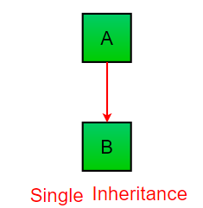
Inheritance
Inheritance is an important aspect of the object-oriented paradigm. Inheritance provides code reusability to the program because we can use an existing class to create a new class instead of creating it from scratch.
In inheritance, the child class acquires the properties and can access all the data members and functions defined in the parent class. A child class can also provide its specific implementation to the functions of the parent class. In this section of the tutorial, we will discuss inheritance in detail.
In python, a derived class can inherit base class by just mentioning the base in the bracket after the derived class name. Consider the following syntax to inherit a base class into the derived class.

Slide 102
Advantages of Inheritance
The following are the few advantages or benefits of using inheritance in Python.
Python Inheritance provides Code reusability, readability, and scalability.
Python Inheritance reduces the code repetition. You can place all the standard methods and attributes in the parent class. These are accessible by the child class derived from it.
By dividing the code into multiple classes, the applications look better, and the error identification is easy.

Slide 103
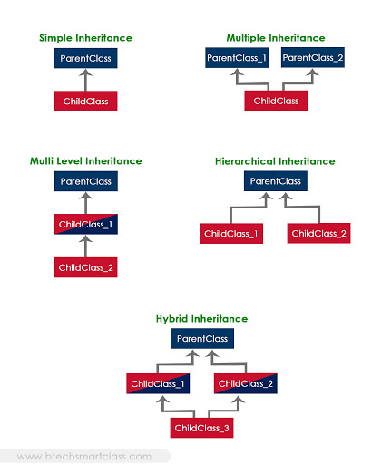
Types of Inheritance

Slide 104
Overloading and Overriding
Overloading
Overriding
In the method overloading, methods or functions must have the same name and different signatures.
Method overloading is a example of compile time polymorphism.
In the method overloading, inheritance may or may not be required.
It is used in order to add more to the behavior of methods.
In method overloading, there is no need of more than one class.
Whereas in the method overriding, methods or functions must have the same name and same signatures.
Whereas method overriding is a example of run time polymorphism.
Whereas in method overriding, inheritance always required.
Whereas it is used in order to change the behavior of exist methods.
Whereas in method overriding, there is need of at least of two classes.

Slide 106
Quiz
Procedural language is less secure?
True
False
2. _____ represents an entity in the real world with its identity and behaviour. a) A method b) An object c) A class d) An operator

Slide 107
Quiz
3.What is the output?
class test:
def __init__(self,a="Hello World"):
self.a=a
def display(self):
print(self.a)
obj=test()
obj.display()
a) The program has an error because constructor can’t have default arguments
b) Nothing is displayed
c) “Hello World” is displayed
d) The program has an error display function doesn’t have parameters

Slide 108
Quiz
4. What is setattr() used for? a) To access the attribute of the object b) To set an attribute c) To check if an attribute exists or not d) To delete an attribute
5. What is getattr() used for? a) To access the attribute of the object b) To delete an attribute c) To check if an attribute exists or not d) To set an attribute
6. What is Instantiation in terms of OOP terminology? a) Deleting an instance of class b) Modifying an instance of class c) Copying an instance of class d) Creating an instance of class

Slide 109
Quiz
7. Is the following Python code correct?
class A:
def __init__(self,b):
self.b=b
def display(self):
print(self.b)
obj=A("Hello")
del obj
a) True
b) False
8. Which of the following best describes inheritance?
a) Ability of a class to derive members of another class as a part of its own definition
b) Means of bundling instance variables and methods in order to restrict access to certain class members
c) Focuses on variables and passing of variables to functions
d) Allows for implementation of elegant software that is well designed and easily modified

Slide 110
Quiz
9. What will be the output of the following Python code?
class A():
def disp(self):
print("A disp()")
class B(A):
pass
obj = B()
obj.disp()
a) Invalid syntax for inheritance
b) Error because when object is created, argument must be passed
c) Nothing is printed
d) A disp()
10Which of the following is not a type of inheritance? a) Double-level b) Multi-level c) Single-level d) Multiple

Slide 111
Quiz
11. What type of inheritance is illustrated in the following Python code?
class A():
pass
class B():
pass
class C(A,B):
pass
a) Multi-level inheritance
b) Multiple inheritance
c) Hierarchical inheritance
d) Single-level inheritance
12. What is the biggest reason for the use of polymorphism? a) It allows the programmer to think at a more abstract level b) There is less program code to write c) The program will have a more elegant design and will be easier to maintain and update d) Program code takes up less space

Slide 112
Quiz
13. Overriding means changing behaviour of methods of derived class methods in the base class.
a) True
b) False
14.How many classes are needed for overriding?
Atleast 2
1
0
15. In _________, methods or functions must have the same name and different signatures.
a)Overriding
b)Overloading

Slide 113
Answers
13.B(Overriding means if there are two same methods present in the superclass and the subclass, the contents of the subclass method are executed.)
14.A
15.B
A
B
C
B
A
D
A
A
D
A
B
C

